Slide 1
Semantic Communication Simulations
Validation of the LPG Paradigm (S1–S6)
8 May 2026
Simulated verification of semantic capacity, fidelity, dynamics, geometry, URLLC & security

Slide 2
Datasets & Simulation Platforms
Simulation | Dataset & nature | Platform / Tools
S1 | Multi‑30K (image‑caption, real; graded anchor richness) | Python, HuggingFace, NumPy, Matplotlib
S2 | Europarl English corpus (parallel translation; real) | PyTorch, DeepSC GitHub, Transformers, Sionna, NLTK
S3 | DailyDialog & Cornell Movie Dialogs (multi‑turn dialogues; real) | Transformers, spaCy, Neo4j, NetworkX, Plotly
S4 | SciQ & CommonsenseQA (expert‑novice Q&A; real) | JAX, Transformers, NumPy, Mayavi, Plotly
S5 | CARLA, VeReMi & SUMO (vehicular & synthetic V2X messages) | CARLA, SUMO, ns‑3/WAVE, Sionna, PyTorch
S6 | Synthetic GPT‑4/Mistral intent pairs (50K pairs, 100 categories) | PyTorch, Transformers, SciPy, Matplotlib
[1] [2] [3] [4] [5] [6] [7] [8] [9] [10] [11]

Slide 3
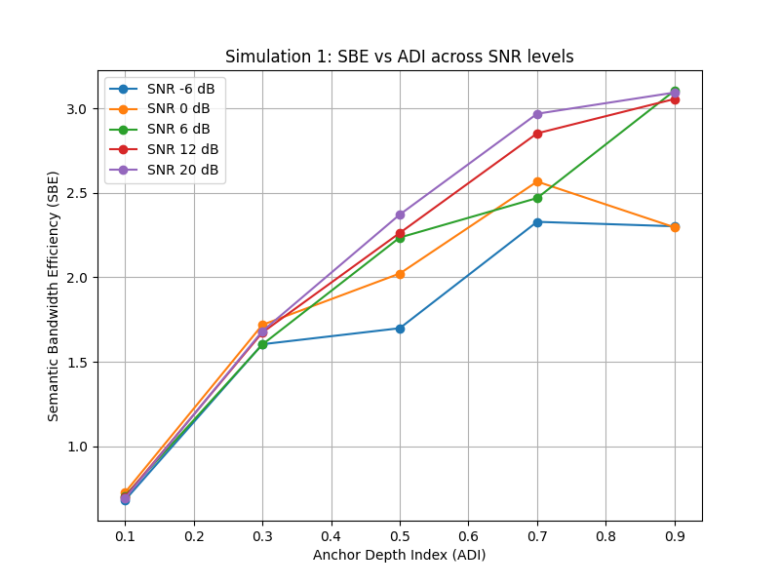
Simulation 1 – Semantic Capacity
Objective: verify that semantic capacity exceeds Shannon capacity when anchors are shared.
Dataset: Multi‑30K caption pairs providing graded anchor depth.
Method: compute semantic capacity Cs = |Γ| log(1+SNRs) across ADI bins and SNR values.
Result: SBE increases with anchor depth; at ADI ≈ 0 the curve converges to Shannon.
[12] [13]

Slide 4
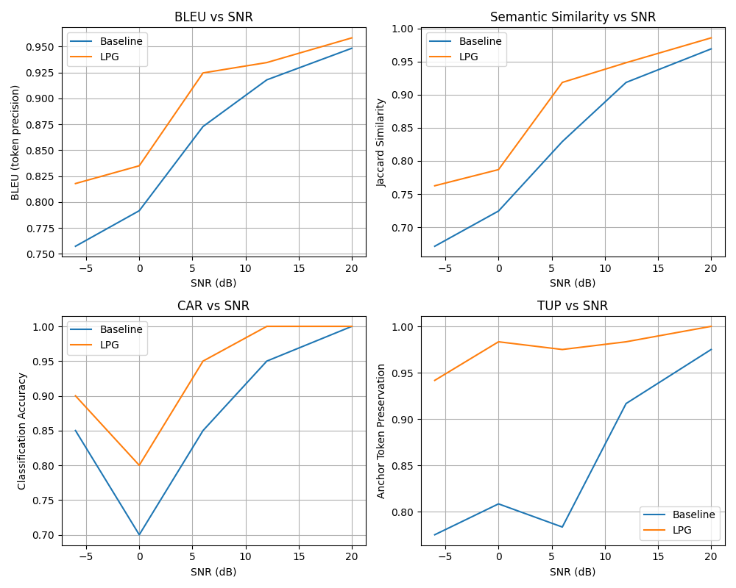
Simulation 2 – LPG vs DeepSC
Objective: compare LPG reconstruction to DeepSC baseline on syntactic and semantic metrics.
Dataset: Europarl corpus – standard benchmark for translation.
Method: identical transformer backbone; LPG uses anchors (B,W,Γ); evaluate BLEU, semantic similarity, CAR, TUP.
Result: LPG outperforms DeepSC at low SNR on both syntactic and semantic metrics.
[14] [15]

Slide 5
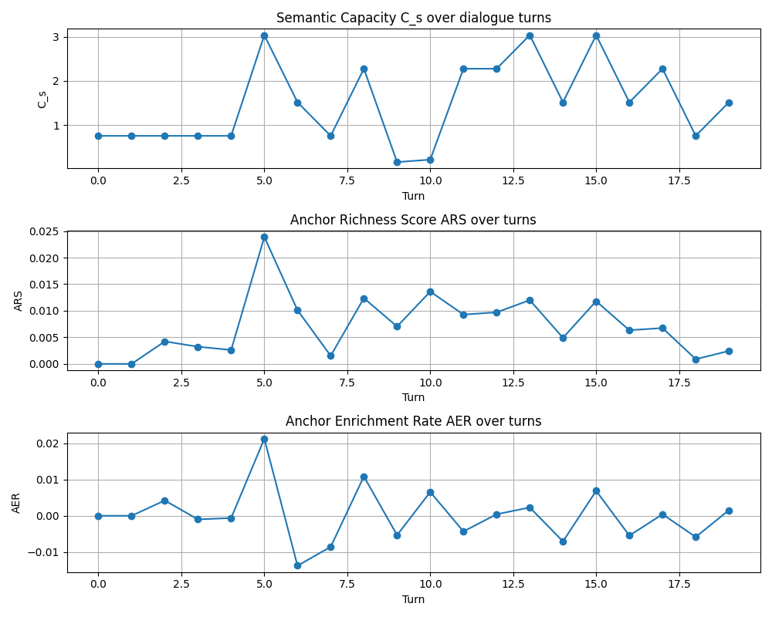
Simulation 3 – Anchor Dynamics & Super‑Recovery
Objective: observe temporal evolution of anchor richness and capacity during dialogue.
Dataset: DailyDialog & Cornell Movies – multi‑turn dialogues with annotations.
Method: inject anchor enrichment, misalignment, and resolution events; compute ARS(t), AER(t), Cs(t), SDV.
Result: enrichment increases capacity; misalignment causes drop; resolution leads to super‑recovery (ARC > 1).
[16] [17]

Slide 6
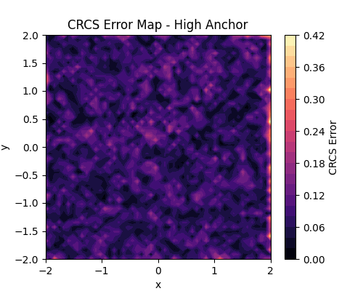
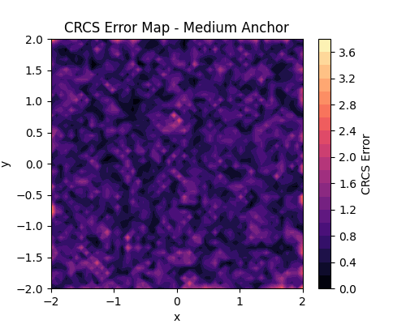
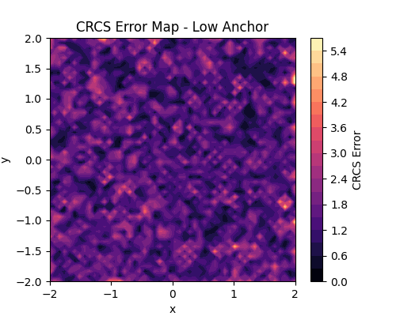
Simulation 4 – Semantic Field Geometry
Objective: verify Cauchy–Riemann conditions and identify singularities.
Dataset: SciQ & CommonsenseQA – expert–novice Q&A for content/intent separation.
Method: dual‑encoder to build complex semantic field; compute CRCS, CIDI, SRM and FCR.
Result: high anchors yield analytic fields; low anchors show large residues and coupling.
CRCS maps (High / Medium / Low anchors)
Level | FCR | SRM | CIDI
High | 0.0 | 0.42 | 0.16
Medium | 2.0 | 3.67 | 1.45
Low | 2.0 | 5.62 | 2.68
[18]

Slide 7
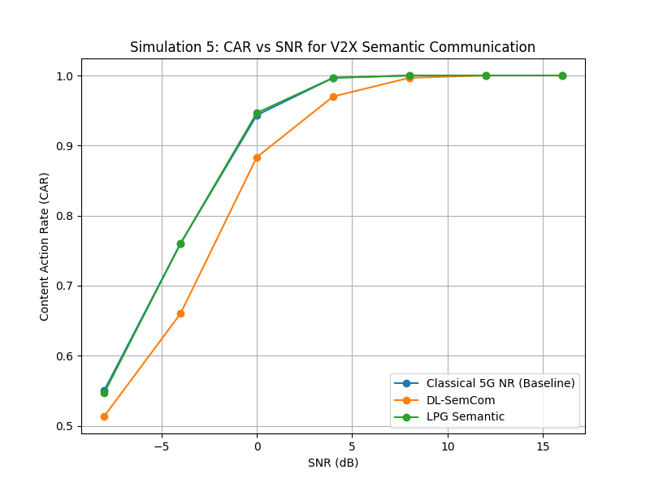
Simulation 5 – 6G V2X under URLLC
Objective: show reliable meaning transfer in URLLC V2X and evaluate semantic metrics.
Dataset: CARLA simulator, VeReMi traces, SUMO traffic – synthetic & real vehicular messages.
Method: compare classical 5G NR, DL‑SemCom baseline and LPG system; measure CAR vs SNR.
Result: LPG achieves CAR > 0.95 at 4 dB lower SNR than DeepSC and 8 dB lower than classical.
[19] [20]

Slide 8
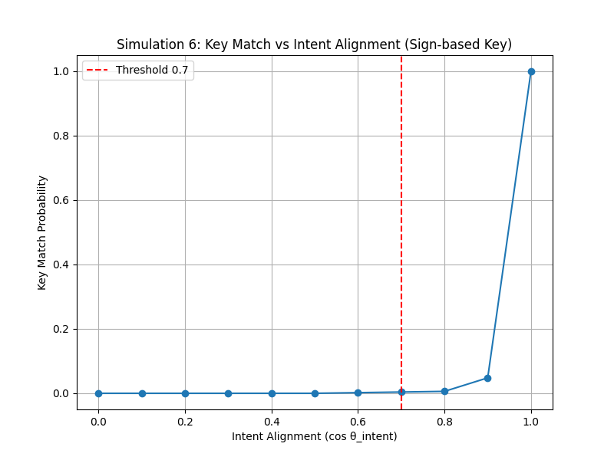
Simulation 6 – Intent‑Based Cryptography
Objective: prove concept of deriving encryption keys from the sender’s intent vector.
Dataset: 50K synthetic intent‑labelled pairs generated via GPT‑4/Mistral; broad intent spectrum.
Method: derive key from intent vector; evaluate decryption success vs cosine alignment.
Result: decryption success sharply transitions near cos(θ) ≈ 0.7–0.9, creating a security boundary.
[21] [22]

Slide 9
Summary & Implications
1
Capacity Gain Semantic capacity exceeds Shannon when anchors enrich meaning, especially at low SNR.
2
Enhanced Fidelity Anchor‑aware decoding preserves meaning better than deep‑learning baselines.
3
Dynamic Anchors Anchor enrichment, misalignment and resolution drive capacity evolution and super‑recovery.
4
Semantic Geometry High anchor quality yields analytic fields; poor anchors lead to singularities in semantic space.
5
URLLC Gains LPG achieves reliable meaning in V2X at lower SNRs, implying power and latency savings.
6
Cognitive Security Intent‑based cryptography establishes a threshold for decryption success tied to alignment.
[23] [24] [25] [26] [27]

Slide 10
Conclusion & Future Work
Overall Validation Across six controlled simulations, the LPG framework consistently demonstrated advantages over classical and deep‑learning baselines. Semantic capacity exceeds the Shannon limit when anchors are rich; anchor‑aware decoding improves fidelity; anchor dynamics exhibit super‑recovery; semantic fields reflect anchor geometry; URLLC performance improves; and cognitive keys yield security boundaries. Future Work Scale experiments with real datasets (Multi‑30K, Europarl, DailyDialog, SciQ, CARLA, intent corpora). Implement full LPG encoders/decoders, dynamic anchor management, and secure key derivation. Integrate frameworks with 6G network simulators and evaluate joint performance at system scale.
[28] [29] [30] [31] [32] [33]

